Slide 1
An Analysis of Crime in Denver
By: John Phillips

Slide 2
Project Overview
Motivation: This analysis attempts to uncover trends and patterns in crime rates and behaviors in the Denver Metro area over the last 5 years.
Agenda: attempt to understand the different factors affecting crime by asking these questions
Do crime rates have a seasonality to them?
Which neighborhoods are the most dangerous?
What socioeconomic factors contribute to more or less crime?
What are the most common types of crime?

Slide 3
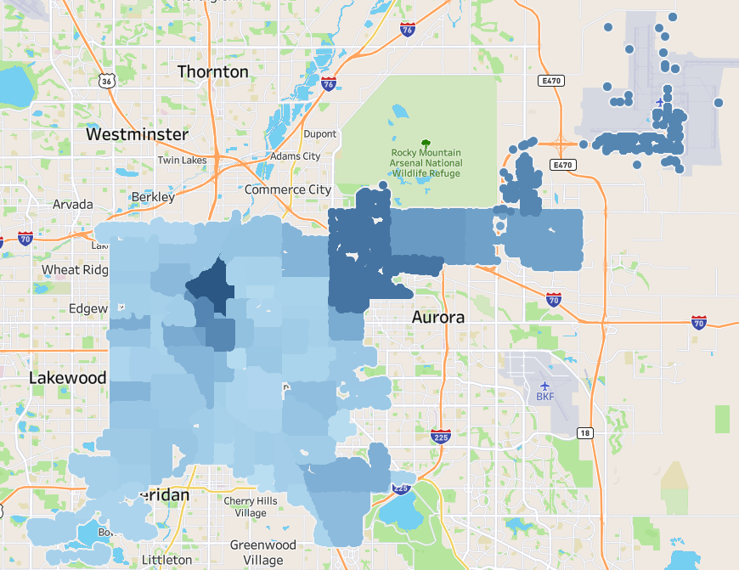
Visualizing Crime in the City
This map shows all 78 Denver neighborhoods.
I created a “danger score” for each neighborhood, which is a composite of crime frequency and number of victims per crime.
The darker the color, the higher the danger score.
The dark blue triangular blotch near the center of the city is Five Points, which had the highest danger score of all neighborhoods.
Central Park, DIA, Central Business District, and Capital Hill round out the top 5.

Slide 4
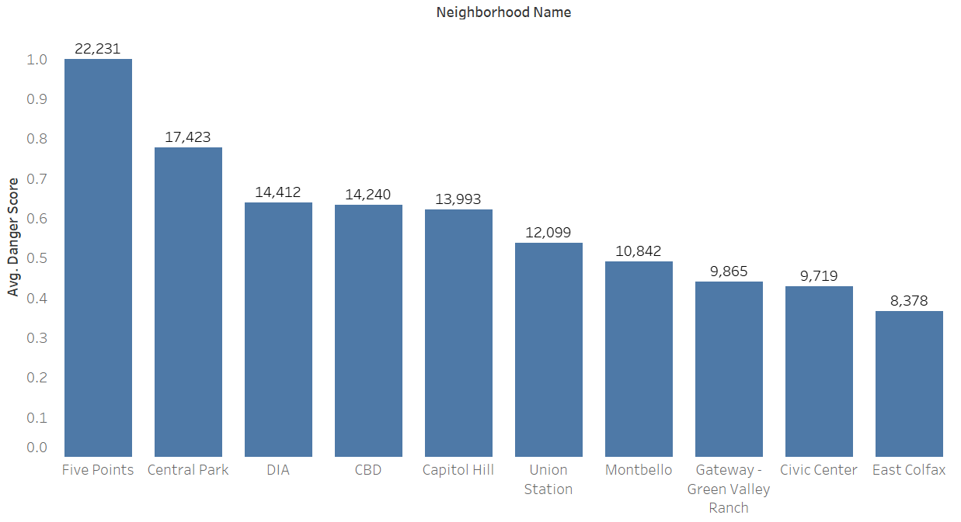
Top 10 Most Dangerous Neighborhoods
Another depiction of the neighborhoods with the highest danger scores.
The numbers above each bar represent the total crimes documented over the 5+ years.
The data representing about 2100 days means that Five Points saw an average of 10.6 crimes documented daily.

Slide 5
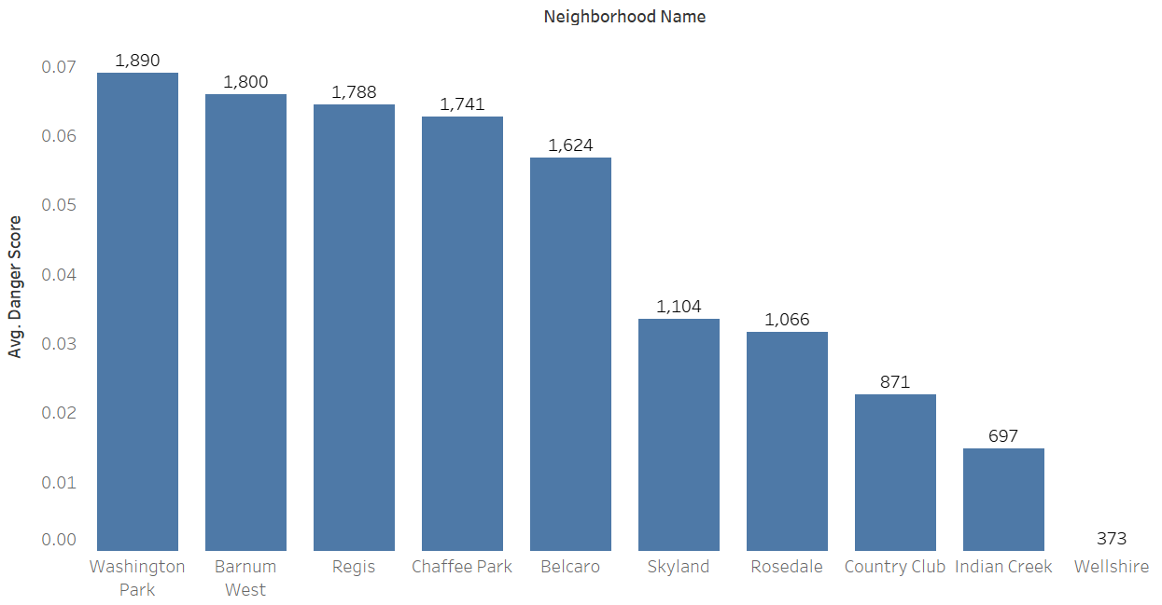
Top 10 Safest Neighborhoods
Conversely, here are the safest neighborhoods in Denver.
For reasons unknown at this point, these areas have created safe environments for their citizens.
Perhaps because of gated communities, higher visibility, or fewer people, their danger scores are the lowest in the entire city.

Slide 6
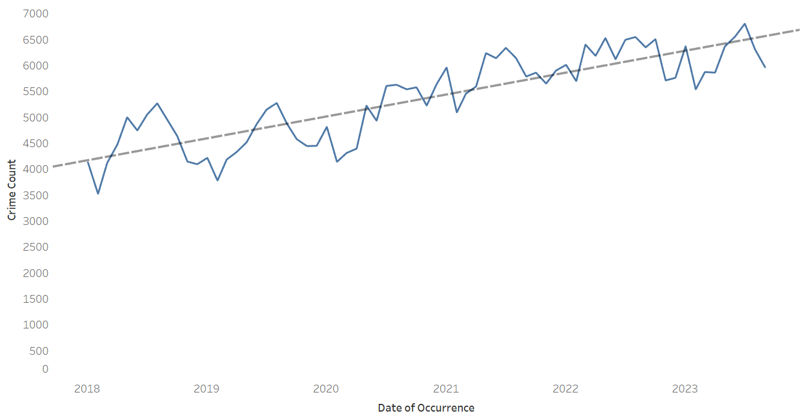
Crime Rates over Time
Yes, crime rates have been increasing.
The inflection point occurs around the start of COVID-19: March 2020.
From there, it increased gradually, with seasonality, and seems to be leveling off.
But why is it going up?
COVID-19 and other economic trends (inflation, etc.) could be squeezing the wallets of many, increasing crime through desperation.
Other reasons include more civil unrest and increased population.

Slide 7
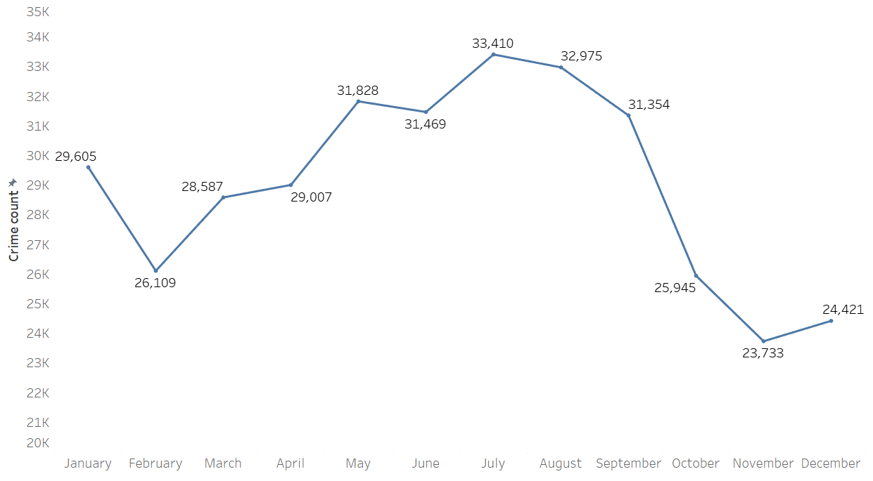
Does the time of year make a difference?
Colder months = colder temps and more inclement weather = fewer people outside = fewer opportunities for crime to occur.
October-December only account for 5 years instead of 6, since the data ends in October of 2023.
This means that October-March averages 160 crimes per day.
April-September averages 10% more crime: 176 crimes per day.

Slide 8
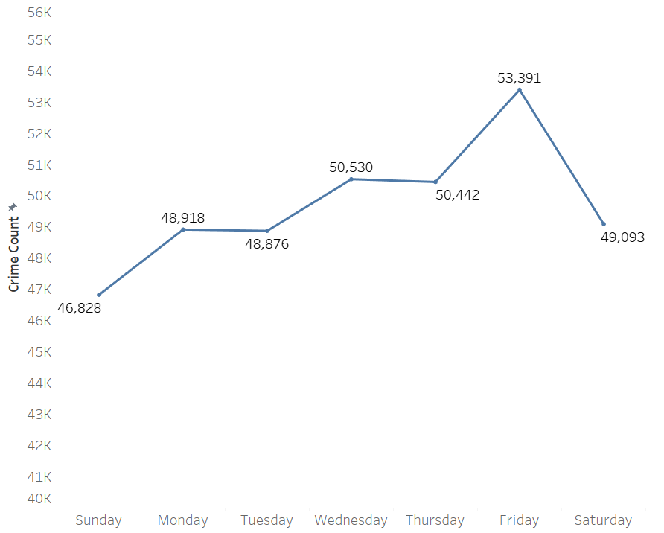
What about day of the week?
Crime peaks on Fridays- why?
This could be due to more city events occurring on that day, which means more people are out and about.
Fridays are also popular drinking days- with the workweek over, many people turn to alcohol to celebrate and unwind.
More alcohol = more crime.

Slide 9
Socioeconomic Factors to Consider
These five socioeconomic variables had the strongest correlation with neighborhood crime:
Vacant Housing Units
Age 20 to 29 (# of people in this age range)
Non-Family Household (# of homes comprised of people not related)
Income less than $10,000
Total Commuters
All five showed a “moderately strong relationship” with the neighborhood danger score.
Young people, low-income, people working on-site jobs, and the presence of neighborhood neglect all have an association with crime.

Slide 10
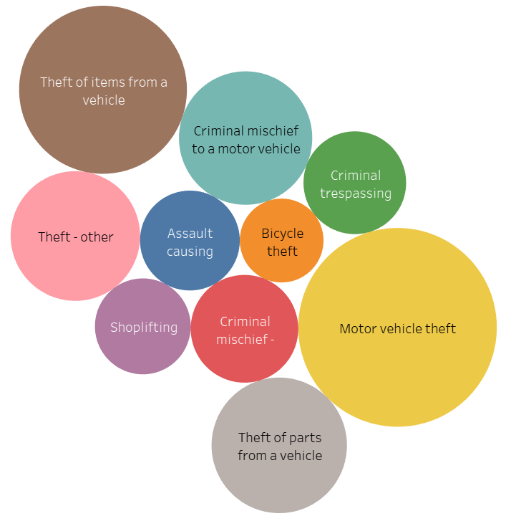
What’s the most common type of crime?
Lock your cars, lock your bikes!
Theft of a vehicle, parts of a vehicle, bicycle theft, “other” types of theft, and shoplifting are all in the top 10 most common reasons.
Criminal mischief to a vehicle (vandalism or destroying parts), “other” criminal mischief, and criminal trespassing are also in the top 10.
The only one involving physical harm to someone is “assault causing minor bodily harm”
This is encouraging since the majority of crime doesn’t directly involve other victims (in the moment of occurrence).

Slide 11
Why is this analysis useful?
While further analyzing could be done to build a higher-resolution picture, we have learned several useful things about the nature of crime in Denver:
More crime happens in the warmer months.
Much of the crime involves theft, typically a whole car or parts of it.
Crime peaks on Fridays.
The most dangerous areas to live are in central neighborhoods or in the northeast corner of the city, near manufacturing and industrial areas.
This analysis can be helpful for those looking to move to the city, and those already living in it.
Lock your cars!!

Slide 12
Main Data Sources
Denver Open Data Catalog (Crime)
Run by the city and county of Denver, it is a public access website for various data sets involving transportation, public safety, education, etc.
Data is based on the National Incident-Based Reporting System (NIBRS)
First published in 2019, currently updated weekly
https://opendata-geospatialdenver.hub.arcgis.com/datasets/geospatialDenver::crime/about
Denver Open Data Catalog (demographic data)
Neighborhood-level data derived from the American Community Survey
Data was combined with the Community Planning and Developments Neighborhoods layer.
https://opendata-geospatialdenver.hub.arcgis.com/datasets/geospatialDenver::american-community-survey-nbrhd-2016-2020/about

Slide 13
Questions?

